Slide 1
Design of a Graphene Biosensor for CRISPR-Based Molecular Detection
BTA0119- BIOLOGY AND ENVIRONMENTAL SCIENCES
S.BlessikA - 192525251
BandarilakshithasankaRreddy-192571085

Slide 2
Introduction
Modern healthcare needs faster and smarter diagnostic systems
Current trend is moving from lab-based testing → portable smart devices
Combining nanomaterials (graphene) with biology (DNA detection)
Early detection with minimal resources

Slide 3
Problem identification
Traditional methods require long processing time
Difficulty in detecting very small amounts of DNA (low sensitivity)-(PCR)
Results are not real-time (delay in diagnosis) -(CULTURE METHODS)
High cost of advanced diagnostic equipment- (IMAGING TECHNIQUES)

Slide 4
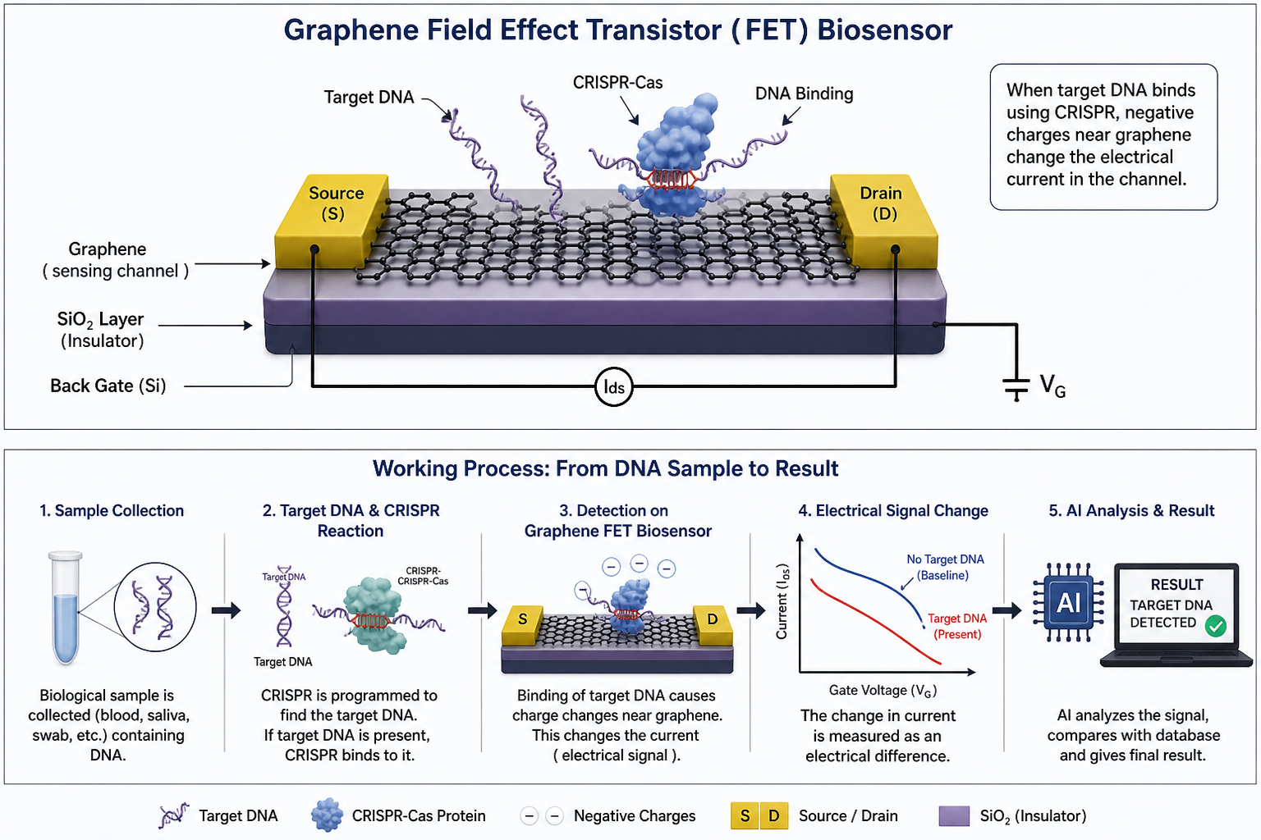
Biosensors overview
A biosensor – A device that detects biological substances
Converts biological reactions into electrical signals
Used in healthcare, environment

Slide 5
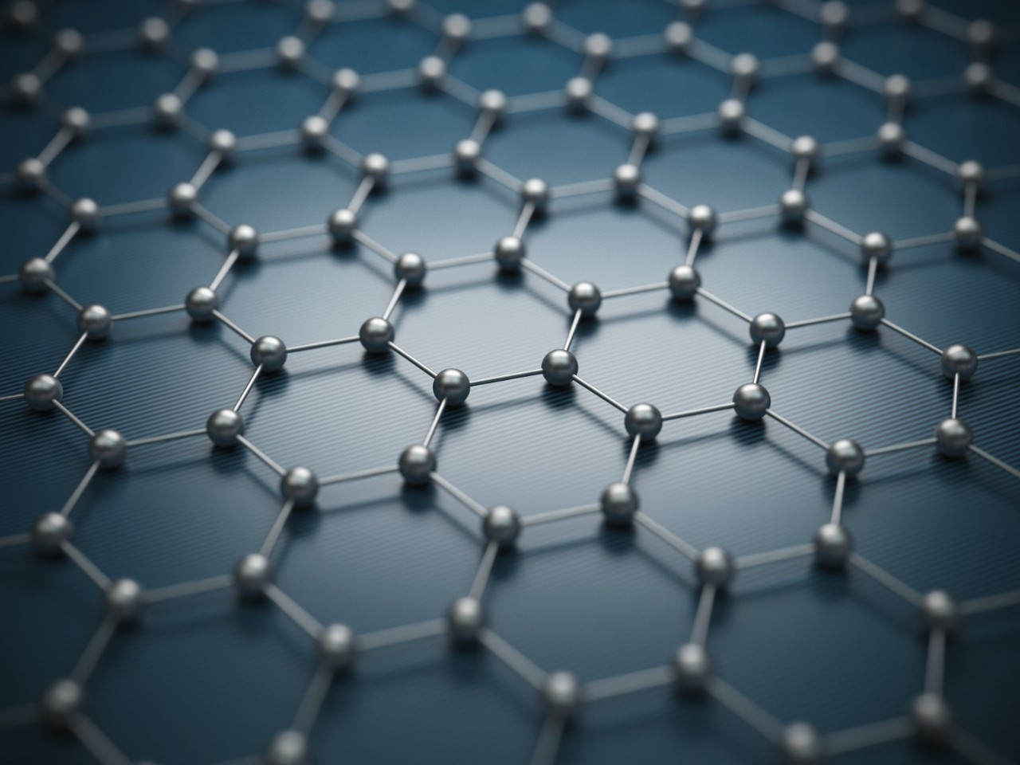
Graphene and it’s importance
Graphene = single layer of carbon atoms
Properties:
1.High conductivity
2.Extremely sensitive
3.Fast signal response
4.Ideal for advanced biosensors

Slide 6
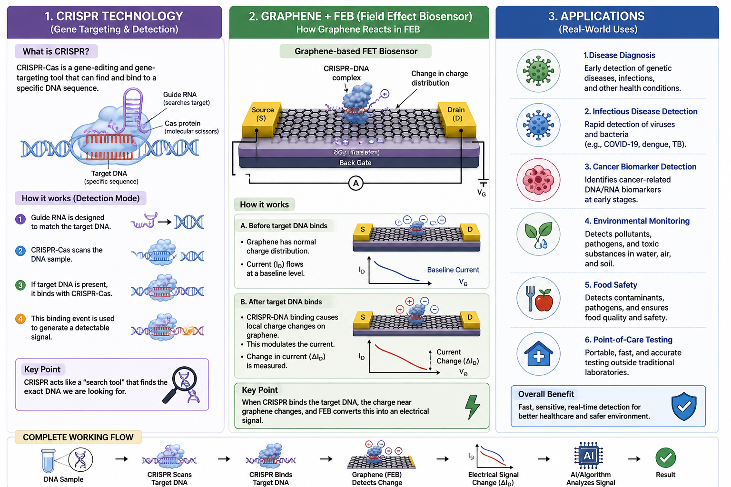
Graphene Biosensors + FEB
Detect DNA, proteins, and biomolecules
Based on Field Effect Biosensing (FEB)
Biological interaction → change in electrical current
Enables real-time sensi
FEB
FEB is a method where biological changes control electrical signals in a device.

Slide 7
CRISPR Technology
CRISPR = gene-editing & detection tool
Identifies specific DNA sequences
Used in:
1.Virus detection
2.Genetic analysis
3.Highly accurate
CRISPR
CRISPR is a tool that can find a specific DNA sequence and attach to it

Slide 8
Working principle
Target DNA binds with CRISPR
Graphene transistor senses change
Signal generated instantly
AI converts signal into result

Slide 9
Applications
Disease diagnosis
Virus detection (like COVID)
Cancer biomarker detection
Environmental monitoring

Slide 10
Results
The system shows high sensitivity, detecting even small amounts of DNA
Provides real-time detection, giving faster results compared to traditional methods
CRISPR ensures accuracy by targeting specific DNA sequences
Graphene sensor detects small electrical changes effectively
AI improves signal analysis and reduces errors
Overall system is fast, reliable, and efficient for molecular detection

Slide 11
Conclusion
Integrates biology, graphene nanotechnology, and AI into a single smart detection system
Enables fast, real-time, and highly sensitive molecular detection
Uses CRISPR for accurate DNA targeting and graphene for precise signal detection
AI improves data analysis, accuracy, and decision-making
Has strong potential to revolutionize future healthcare and diagnostics

Slide 12
THANK YOU

